Slide 1
“On the way with Python”

Slide 2
MD. SHAKIL
NSDA Certified Trainer & Assessor
Vendor Certified
IT Specialist in Python
Sr. Backend Developer
Ethical Den
Asst. Trainer
Daffodil International Professional Training Institute
Lead Trainer
eShikhon IT Training Institute
Lead Trainer
Wizard Software & Technology
📞 +88 01793-299882
✉️ shakil.eub.cse@gmail.com
🔗 https://www.linkedin.com/in/mrshakil015
🌐 https://mrshakil.com

Slide 3
Python Input/Output
Lecture
03

Slide 4
Introduction
Input and Output (I/O) are essential parts of any programming language. Input is used to take data from the user, and Output is used to display results to the user. Python provides simple and powerful functions for handling input and output.

Slide 5
“Output in Python”

Slide 6
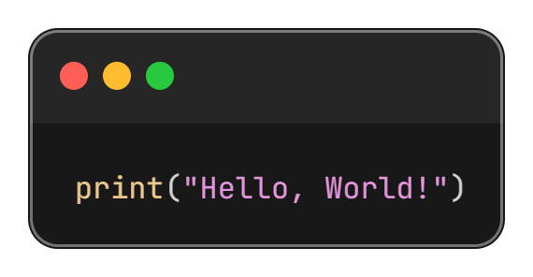
Output in Python
Python uses the print() function to display output on the screen.

Slide 7
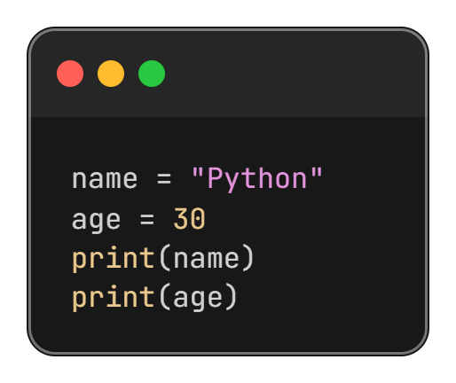
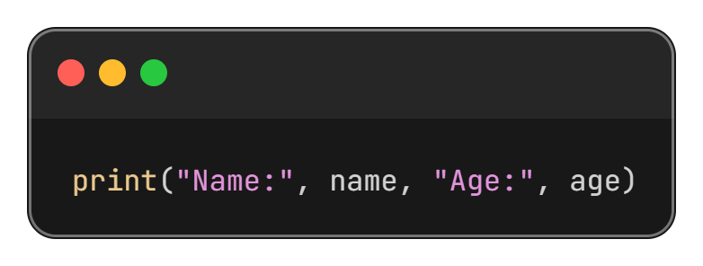
Printing Variables
Printing Multiple Values
Printing Single Value

Slide 8
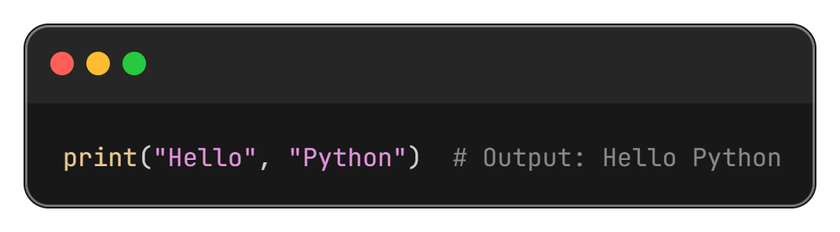
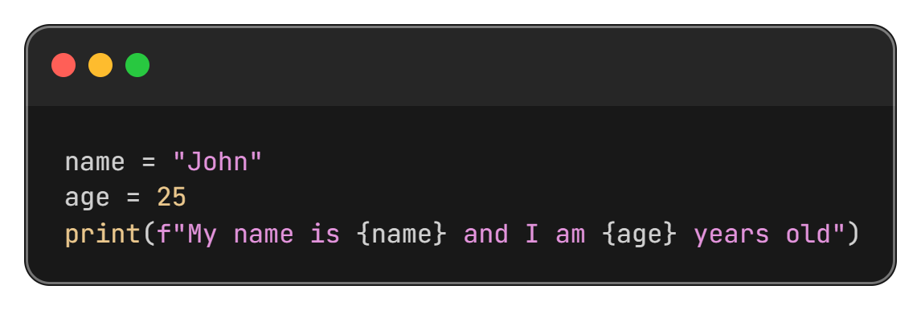
Formatting Output
Using Comma ( , ): Automatically adds space between values.
Using f-strings:

Slide 9
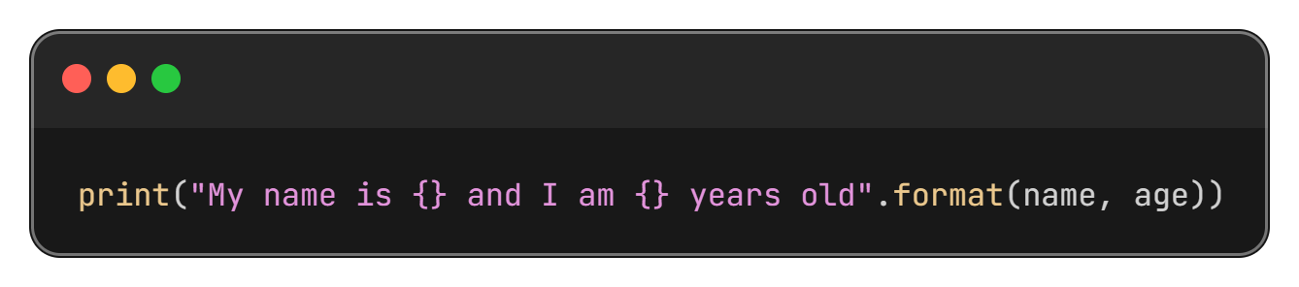
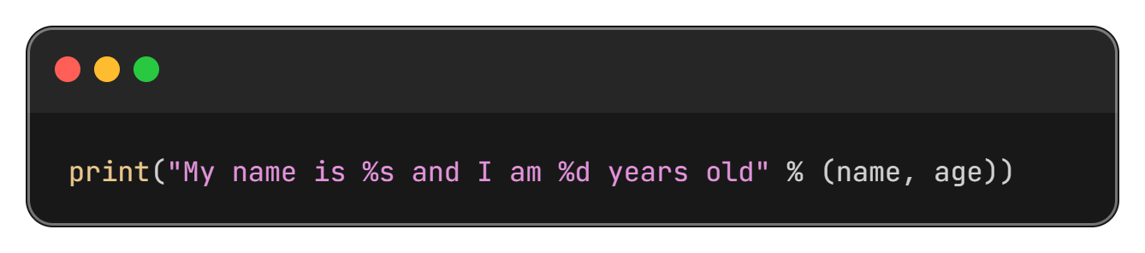
Formatting Output
Using format() Method
Using % Operator

Slide 10
“Input in Python”

Slide 11
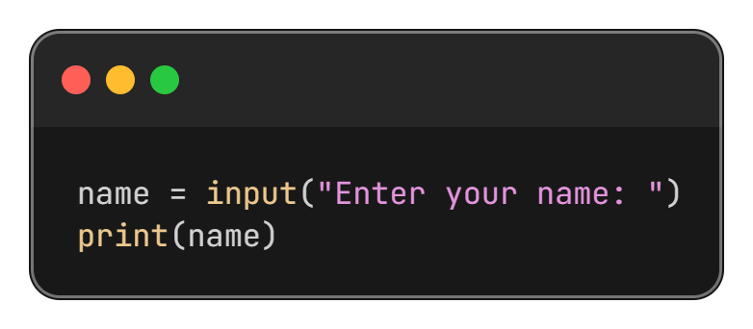
Input in Python
Python uses the input() function to take input from the user.
Important Note: The input() function always returns data as a string.

Slide 12
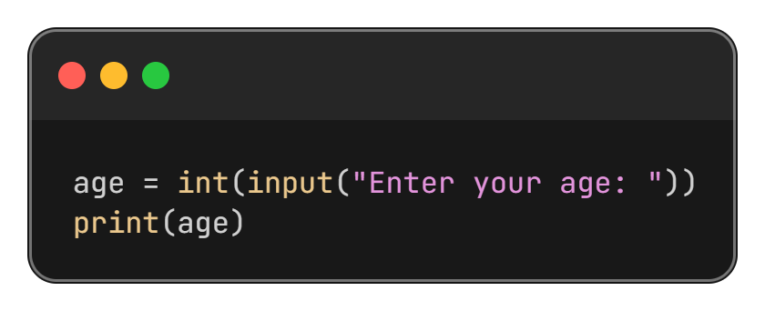
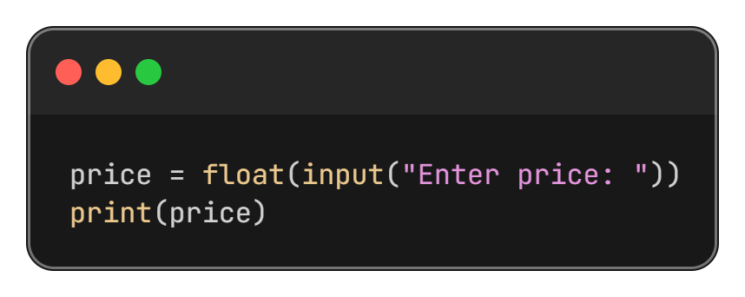
Type Conversion with Input
To perform calculations, input values must be converted into required data types.
Integer Input
Float Input

Slide 13
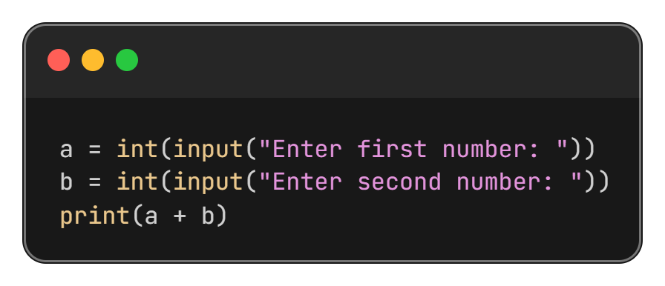
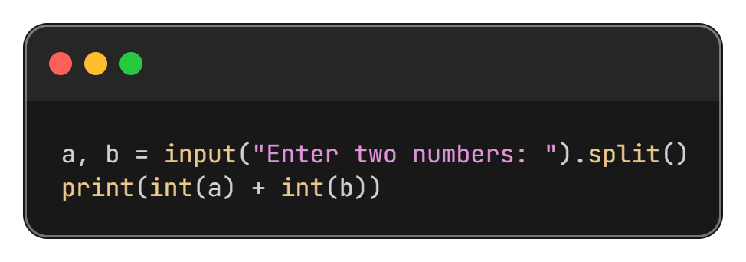
Taking Multiple Inputs
Using Multiple input() function calls
Using split()

Slide 14
““Thanks All””

